Slide 1
Learn how to make your (R) code more secure
R User Meeting
14 January 2026 – Jacob Rousseau

Slide 2
Introduction
Jacob Rousseau, Developer and AI-consultant, Dept. Research Data Management,
Amsterdam University Medical Center (AmsterdamUMC)
J.B.I.Rousseau >at< amsterdamumc.nl
Risks
Exploit categories
Exploit life-cycle
Exploit registration
Research software, Git & Security
Notes:
Please contact Merel or me if you want a copy of the presentation
Short bio: developer, experience in research and financial domains and former Certified Information Systems Security Professional (CISSP)
Please don’t hesitate to ask a question during the presentation if a term used is unknown or not clear to you.
Confucius:
“A person who asks a question is a fool for a minute, a person who does not ask is a fool for life.“
PHI GDPR has the highest possible level

Slide 3
Exploit categories
Hardware: targets hardware with embedded code
Software: targets software
Network: targets network components (DNS, routers, switches, DDOS )
Zero-day: exploits not publicly known
Exploit life-cycle
Creation either accidentally or maliciously
Usage when only known by malicious actors or not fixed ( patched )
Exploit discovery and publication ( responsible disclosure )
Exploit registration
Development of patches to eliminate exploit
Apply patches on end-systems
Notes:
Zero day exploits
Discovery can be done with ‘responsible disclosure’. The discoverer only informs the software owner(s) and subsequently registers it in CVE register with non-disclosure/confidential status.
And the publication of the exploit is only done after patches have been applied

Slide 4
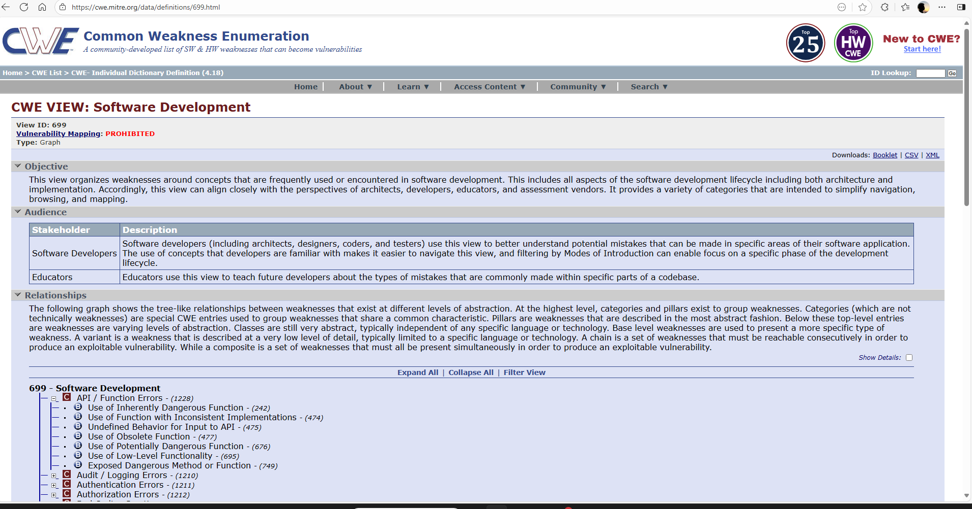
Exploit classification: https://cwe.mitre.org
Notes:
CWE Common Weakness Enumeration is maintained by a consortium of US governmental security organizations: e.g. DHS ( Department of Home Security, CISA Cybersecurity and Infrastructure Security Agency etc )
The ontology of security weaknesses

Slide 5
Exploit Registration
Common Vulnerabilities and Exploit ID ( CVE )
National Vulnerability Database ( USA )
Nationaal Cyber Security Centrum NCSC ( The Netherlands )
Open Source Vulnerability Database
Let’s see at how R fares
Notes:
CVE site is the de facto-standard for exploit registration
CVS-2026-000001

Slide 6
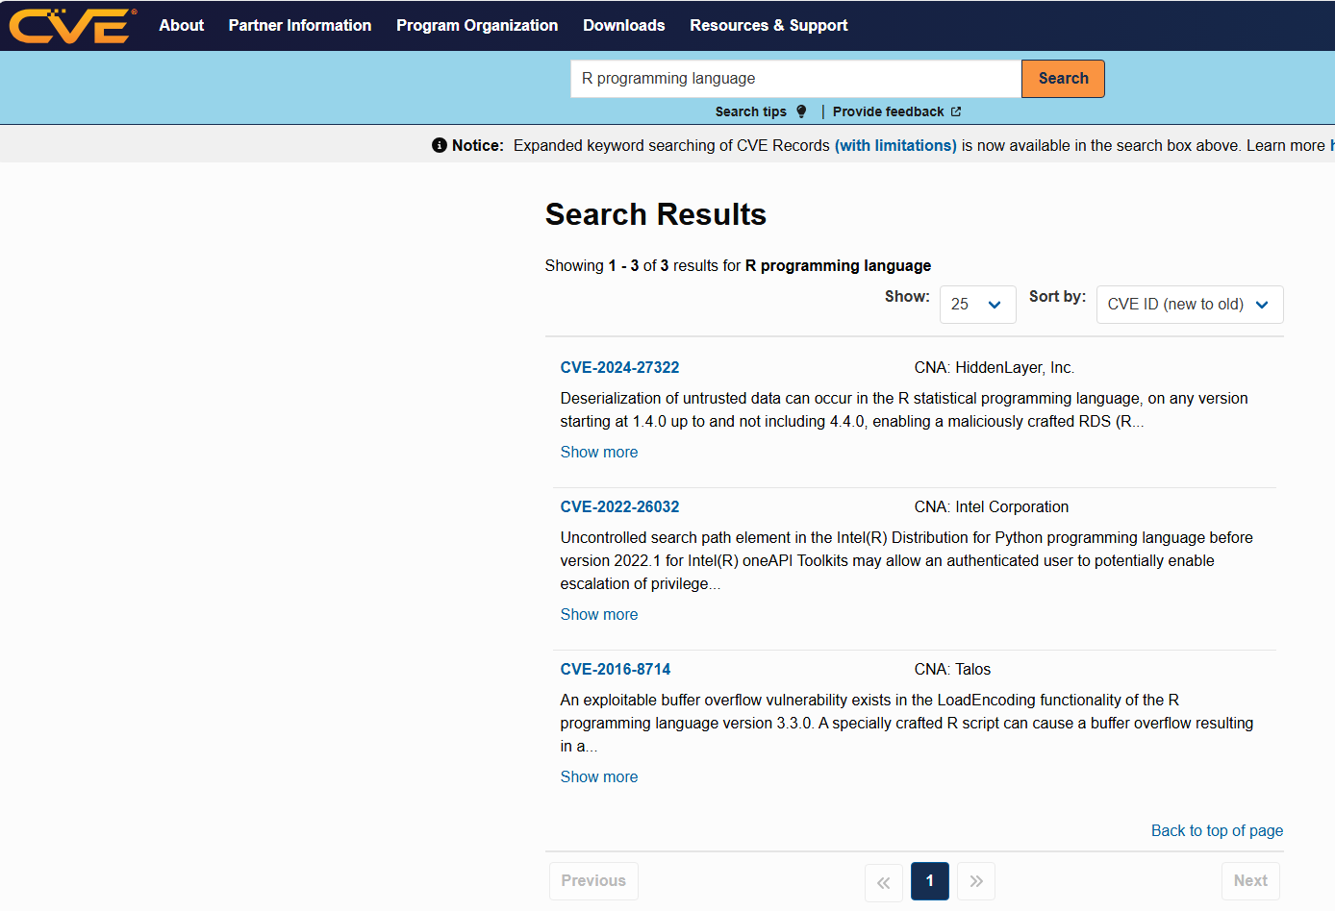
CVE search term: R programming language
3 exploits since 2016
CVE-2016-8714
CVE-2022-26032
CVE-2024-27322
Notes:
Go to the web site of the Common Vulnerability and Exposures registry:
URL: https://www.cve.org/

Slide 7
Exploit Vectors
R has a good score
not used for web-applications
a well-designed language
usage scope is largely local
Exploits via Web ( OWASP Open Worldwide Application Security Project )
However: exploits are possible in R from user input: e.g. command-line input or SQL commands
Notes:
Technical term: web-facing applications

Slide 8
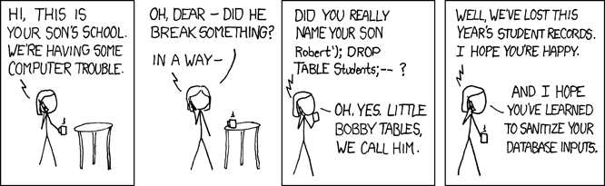
Exploit in code example: SQL-injection
https://xkcd.com/327/
"INSERT INTO Students VALUES('" + FNMName.Text + "', '" + LName.Text + ')";
"INSERT INTO Students VALUES ('Robert'); DROP TABLE Students; --’, ‘XXXXX’)"
https://stackoverflow.com/questions/332365/how-does-the-sql-injection-from-the-bobby-tables-xkcd-comic-work

Slide 9
Risk mitigation Solutions
Types of users and possible interactions with data:
Type of user / usage scope:
only you, your department, some external colleagues or the entire world
Privacy risks, data loss and disclosure risks ( CIA and BIV )
Access routes and possible sources of input
Web
Local environment ( Shell, Rstudio )
API’s
Notes:
BIV = Beschikbaarheid, Integriteit, Vertrouwelijkheid
CIA = Confidentiality, Integrity and Availability

Slide 10
Solutions and tips for code security
SQL-injection: Parameterize queries with R-function ‘sqlInterpolate()’ and sanitize input
Check the SHA256 hash of tools you import for use
Monitor vulnerabilities found in the programming language you use
Scan for vulnerabilities in your own code and in libraries used ( SBOM Software Bill Of Materials ) hrbrmstr/sbom: Generate Software Bill of Materials for R Things
Assess the activity on the repository of the library you intend to integrate in your project
Minimize confidential information emails and names in your code
DON’T put API-access tokens, keys and passwords in your code.
Notes:
Don’t write input sanitation yourself but find a widely used, active library to do this for you.
Note: the hrbrmstr/sbom project is example of a project which should be approached with care: only one developer and last commit some time ago
Use the best language specific solution(s) for secure storage and use of passwords and keys
And by the way: also monitor vulnerabilities found in the programming language you use

Slide 11
Git: Be aware and beware
Understand how git works
Familiarize your self with git concepts and storage locations
Use .gitignore if you need to access to local data
Always check what you are about to commit and subsequently push
Perform adequate checks before you make you code public
It is very hard / impossible to remove accidentally committed confidential data using Git / GitHub
Once someone forks your repository all data and modification history is included in the fork
Notes:
On github this means, amongst other changing project status from private to public

Slide 12

Code security websites
Open Source Security Foundation guides →
https://github.com/ossf
Anaconda:
‘The ultimate guide to open source security with Python and R’ →
https://www.anaconda.com/guides/the-ultimate-guide-to-open-source-security-with-python-and-r

Slide 13
Data and general security
Backups think about it ask colleagues about backups
Beware of the confidentiality / ( vertrouwelijkheids ) level of your data
Run in secure / virtual environments
Strictly separate code from data - a separate data directory can be defined in .gitignore
Notes:
For backups look at for example: NCSC - Een back-up strategie opstellen

Slide 14
Organizational security
Be aware of the licenses of your libraries
The ‘normal’ security stance and awareness: phishing, social engineering etc.
Cyber Resilience Act for digital products, European legislation since November 2024
Notes:
Confidential data can also be stored in an external DB and accessed with a DBC connection. In this case only the access and connection must be secured

Slide 15
Questions and Answers
Confucius:
“A person who asks a question is a fool for a minute, a person who does not ask is a fool for life.“

Slide 16


Slide 17
Notes / ideas
Mention software repo’s
CRAN
GitHub
OWASP for Web apps
CVE score and site Demo of CVE score and show them the good R record.
Exploit registries ( CVE, Open Source Vulnerability Database ( OSVDB ) )
Exploit classification CWE site
Code scanners
Library scanners
Licensing
Two types of security: technical or organizational ( reputation-loss, litigation if you incorrectly use restricted licensed libraries )
Malicious actors vs Ethical hackers and accidental exploits ( e.g. Log4J )
SBOM Visit hrbrmstr/sbom: Generate Software Bill of Materials for R Things and have a look in the contents of the SBOM, a SHA256 is to be seen. Explain what SHA256 is if someone needs elaboration on it.
A intro on the classes of exploits ( Matrix per language and exploit class ? )
Maybe a SQL-injection demo in R → Solution is given in this site: parameterized queries, but also consider escaping characters
Responsible caretakership: depends also on the usage scope of your code: yourself, your department, a few external colleges or the whole world
Tips: check the SHA256 of your downloaded code
Always look for code on the net first rather than writing it yourself (unless it does exist yet, he he he).
Run in containerized environments
Use a vulnerability scanner for libraries and your own code
Always check your external input (e.g. user input or deserialized data; always know the origin / provenance of your data
Web-facing applications are a whole different ballgame with a lot of extra security aspects ( cf. OWASP )
R is a well developed language, since it is an interpreted one, used mostly only locally (not web-facing) and was developed by experienced people
Make this a language independent presentation e.g. R, Python, Rust, Java, C etc.

